Slide 1
High Cloud Analysis
By Group 5

Slide 2
Contents
Objective
Project scope
Data model challenges
Dashboard overview
Insights
Conclusion

Slide 3
Objective
To understand the operations of ‘High Cloud Airlines’ through various metrics.
Metrics will involve load factor, top carriers for the airlines, passenger preferences for different airlines, popular routes and other metrics
Achieve comprehensive understanding to enhance the operations and efficiency for the airlines.

Slide 4
Project scope
The scope of the project is to extract valuable data driven insights which can help optimize the operations and performance of High Cloud Airlines using different key performance indicators (KPIs) such as:
Load Factor
Preferred Airlines
Popular routes

Slide 5
Data model challenges
There were some challenges that we came across, they were detrimental for the usage of the analysis, it was important to overcome those for accurate indicators
Ensuring the quality of the data is very important for accuracy of the analysis.
Defining relationships between different datasets which can help you in understanding different metrics.

Slide 6
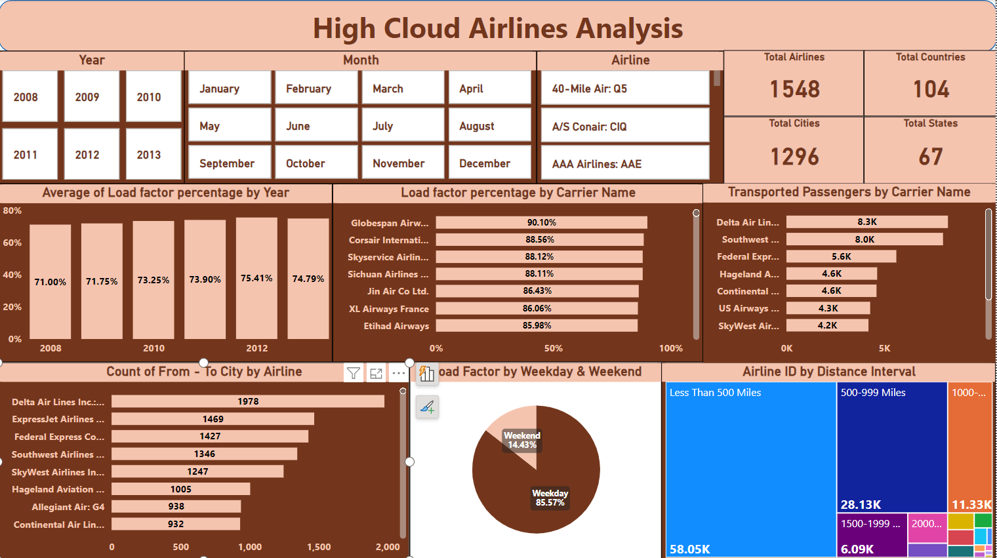

Slide 7
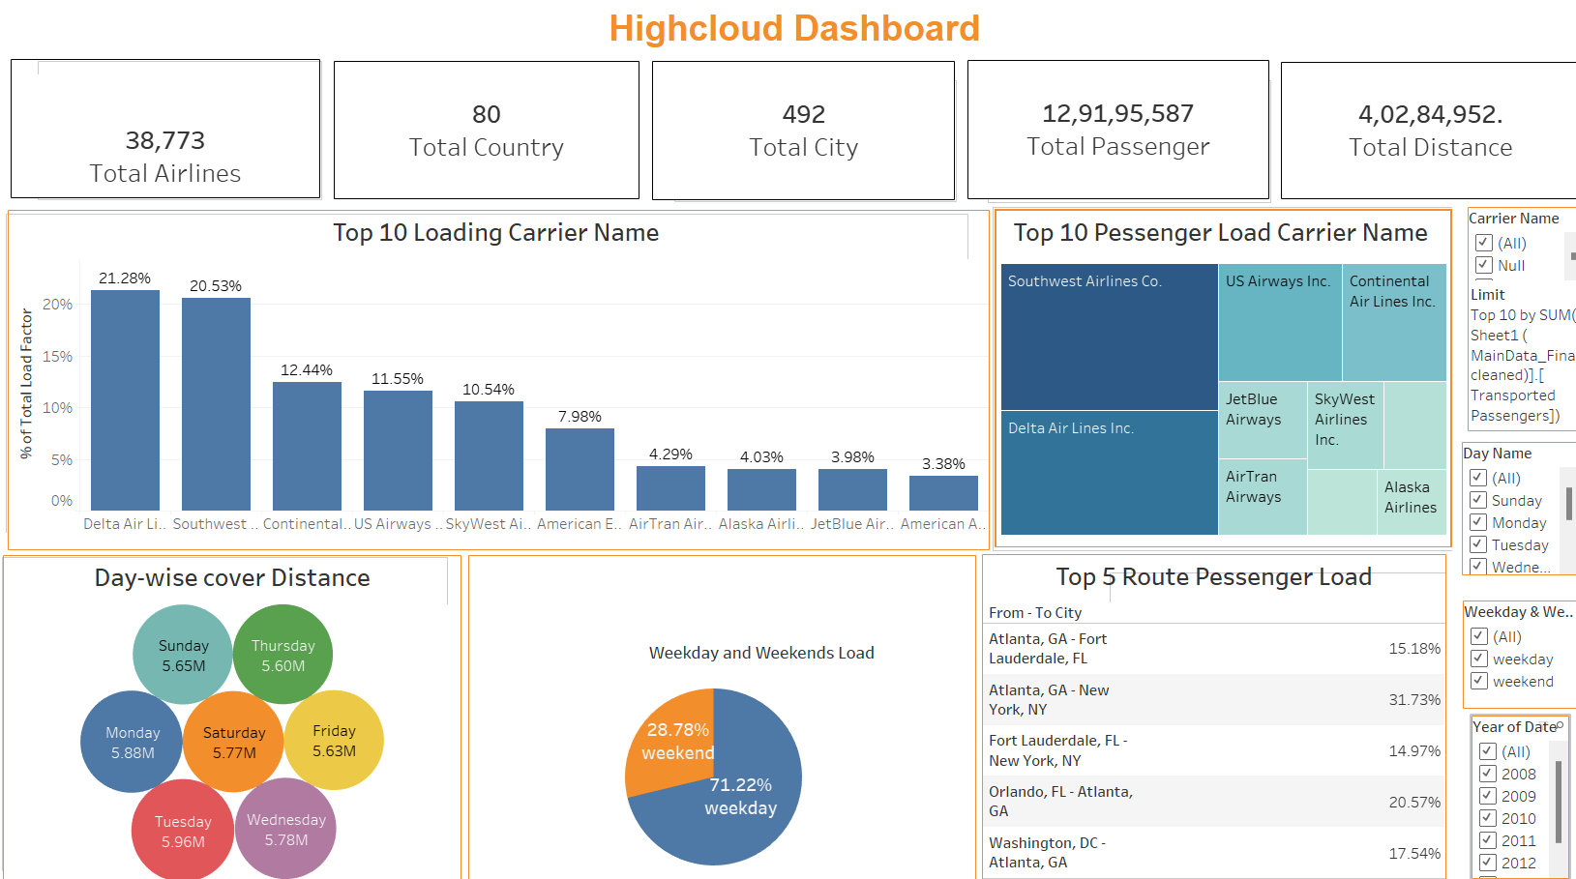

Slide 8
Insights
Load factor : With the help of this KPI we can efficiently plan different flights for the load factor. We can deduce that Globespan Airways (90.10%) is the most efficient carrier with Corsair international (88.56%) being behind it.
Flight routes : On some routes the number of flights higher compared to others. Delta airlines (1987) and ExpressJet Airlines (1469) are two leading airlines in this category.
Passenger Preference: We can infer the most liked airlines by passenger with help of this KPI. Delta Airlines (8.3k) and Southwest Airways (8k) have transported most passengers.
Distance Travelled by Airlines: With this metric we know that number of flights with less that 500 miles is the most being 58.8k. The count of flights more than 8000 miles is only 32.

Slide 9
Conclusion
High Cloud Analysis can help in taking steps to increase efficiency and planning.
The KPIs provided can be useful for increasing or decreasing the number of flights for increased efficiency, staff management, route planning.
The KPIs can also be useful to understand what customers prefer and the actions that are to be taken to be more structured and organized.
Routes with high number of flights can be paired with customer preferred flights for coherency and customer satisfaction.

